Slide 1
Semantic tableau proof method
Terebeș Liviu Cristian

Slide 2
Problem statement
Check the validity of the following first-order formulas using the semantic tableaux method: U₇ = (∃y)(∃x)P(x,y) ↔ (∀x)(∃y)P(x,y)
Using the logical equivalence U ↔ V ≡ (U → V) ∧ (V → U), we can split U₇ into U₇₁ and U₇₂ and check their validity using the semantic tableaux method
U₇₁ = (∃y)(∃x)P(x,y) → (∀x)(∃y)P(x,y)
U₇₂ = (∀x)(∃y)P(x,y) → (∃y)(∃x)P(x,y)
U₇ ≡ U₇₁ ∧ U₇₂
So, U₇ is valid if and only if both U₇₁ and U₇₂ are valid

Slide 3
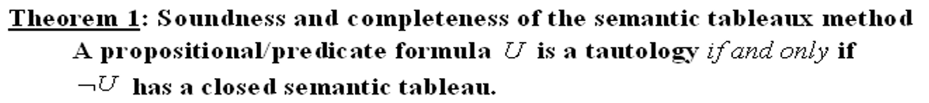
Checking the validity of U₇₁ and U₇₂
We will use the soundness and completeness theorem to find the validity of U₇₁ and U₇₂, by constructing the semantic tableau of ¬U₇₁ and ¬U₇₂

Slide 4
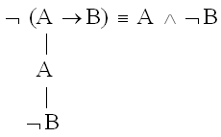
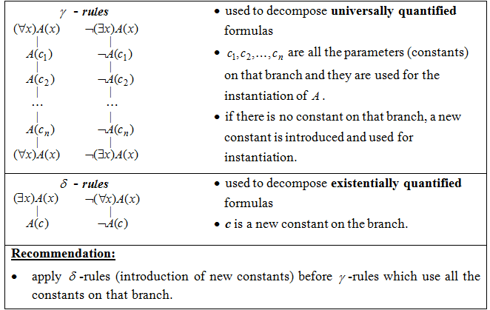
¬ U₇₁ = ¬ ((∃y)(∃x)P(x,y) → (∀x)(∃y)P(x,y)) (1)
α-rule for (1)
α-rules
(∃y)(∃x)P(x,y) (2)
(apply De Morgan’s
laws)
¬(∀x)(∃y)P(x,y) (3)
≡ (∃x)(∀y) ¬P(x,y)
δ-rule for (2), b-new constant
(∃x)P(x,b) (4)
δ-rule for (4), a-new constant
P(a,b)
δ-rule for (3), c-new constant
c is a new constant
(∀y) ¬P(c,y) (5)
γ-rule for (5), b-used for instantiation
¬P(c,b)
(∀y) ¬P(c,y) (5) (copy)
⊙
Conclusion: We have a complete and open branch, therefore U₇₁ is not valid (⊭ U₇₁)
c1, c2, … cn are existing constants on the branch

Slide 5
α-rules
¬ U₇₂ = ¬ ((∀x)(∃y)P(x,y) → (∃y)(∃x)P(x,y)) (1)
α-rule for (1)
(∀x)(∃y)P(x,y) (2)
(apply De Morgan’s
laws)
¬ (∃y)(∃x)P(x,y) (3)
≡ (∀x)(∀y) ¬P(x,y)
γ-rule for (2), a-new constant
(∃y)P(a,y) (4)
c is a new constant
(∀x)(∃y)P(x,y) (2) (copy)
δ-rule for (4), b-new constant
P(a,b)
γ-rule for (3), a-used for instantiation
(∀ y) ¬P(a,y) (5)
γ-rule for (5), b-used for instantiation
¬P(a,b)
(∀ y) ¬P(a,y) (5) (copy)
c1, c2, … cn are existing constants on the branch
(if there are no constants on the branch, a new one is introduced)
⨂
Conclusion: We have a closed branch, so U₇₂ is valid (⊨U₇₂)

Slide 6
Conclusion
Remember that U₇ = (∃y)(∃x)P(x,y) ↔ (∀x)(∃y)P(x,y) and that U₇ ≡ U₇₁ ∧ U₇₂
Using the semantic tableaux method, we proved that ⊭U₇₁ and ⊨U_{72.} This means that ⊭ (U₇₁ ∧ U₇₂), or that ⊭ U₇
In conclusion, U₇ is not a valid formula.

Slide 7
Thank you!

